Slide 1

Spring Boot - RestTemplate
Postman client
CRUD Request
SpringBootRestTemplateDemo
SpringBootDemo
DB
CRUD Response
Using RestTemplate Call the SpringBootDemo application
REST End points and get the result
Create REST End Point
Update REST End Point
Get REST End Point
Delete REST End Point

Slide 2
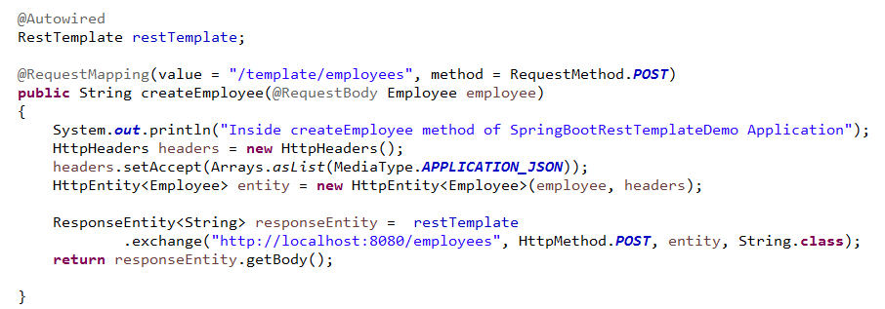
Spring Boot - Rest Template
We will have to follow the given points to consume the API −
Autowired the Rest Template Object.
Use HttpHeaders to set the Request Headers.
Use HttpEntity to wrap the request object.
Provide the URL, HttpMethod, entity and Return type for Exchange() method.
RestTemplate is used to create applications that consume RESTful Web Services. You can use the exchange() method to consume the web services for all HTTP methods.

